Slide 1



Predicting dogecoin price bubbles using epidemic modelling
A study on application of EPI research on Crypto domain
Garimendra Verma
Surya Teja Adluri

Slide 2
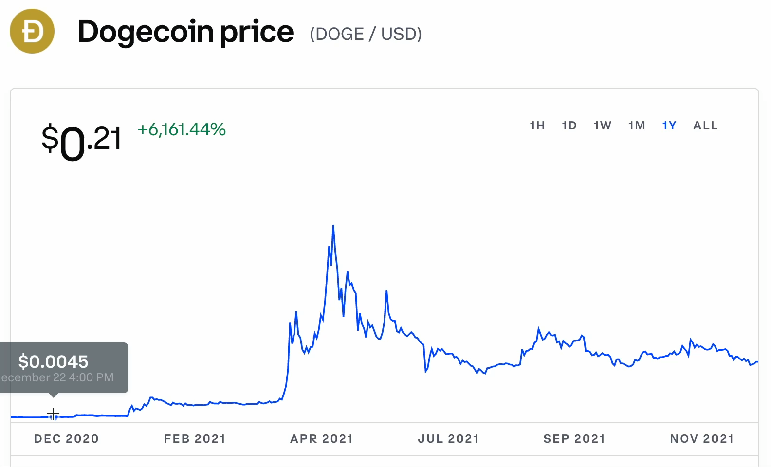
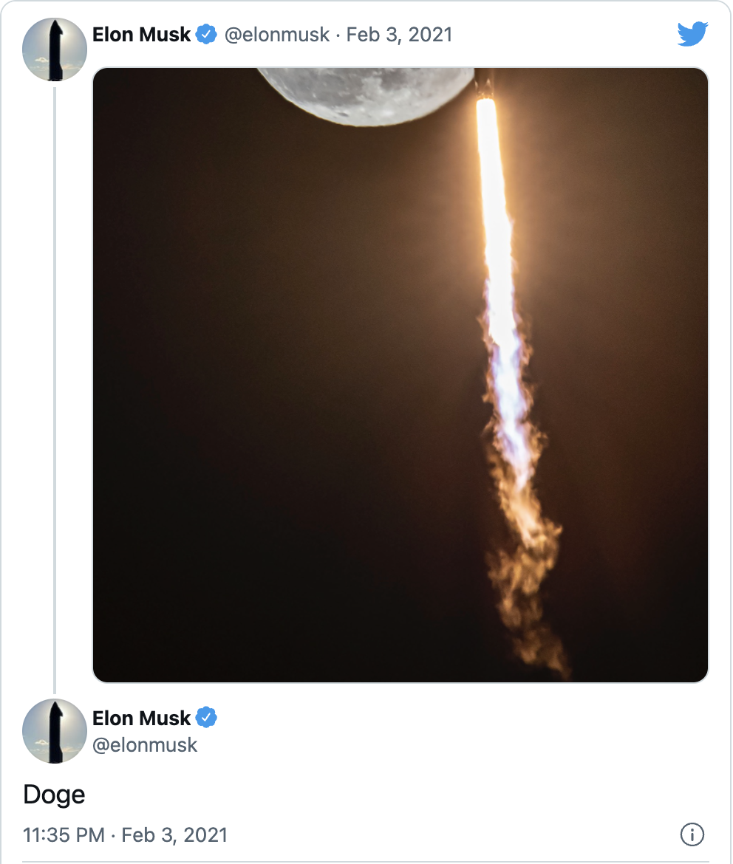


Motivation
Notes:
For something which wasn’t even valued worth a penny sees a rise in it’s price over span of a week hitting it’s then all time high of over 0.05 USD, now that’s exactly a 5x growth in the value of a coin which started gaining a lot of attention and of course we can’t ignore the factors coming into play like these tweets and posts on reddit. Financial price bubbles have previously been linked with the epidemic-like spread of an investment idea; such bubbles are commonly seen in cryptocurrency prices.

Slide 3
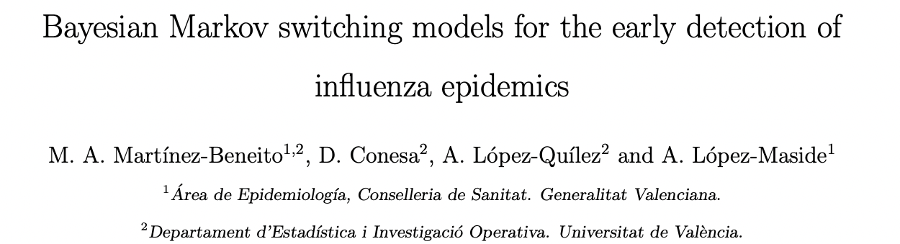
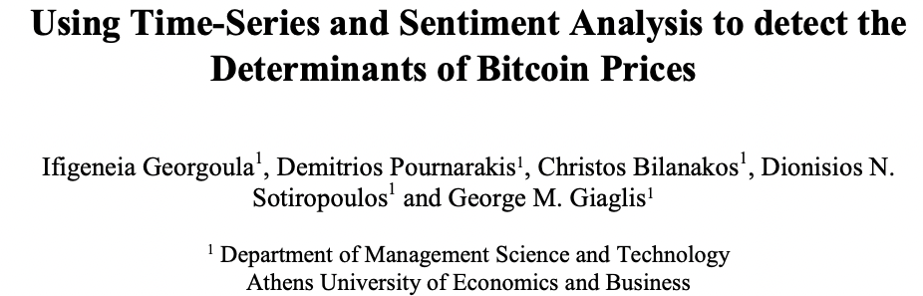
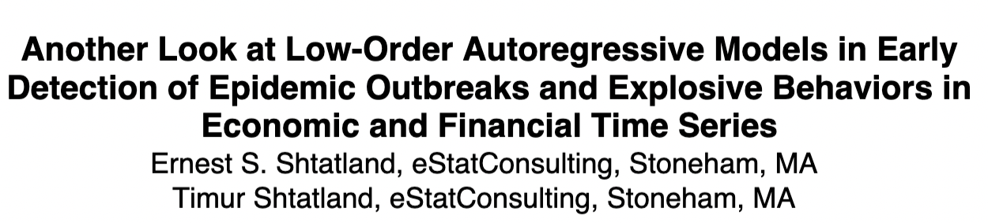
intuition
Notes:
The reason behindthis is the volatility and price bubbles of the cryptomarket. There has also been some research on howcryptocurrency price bubbles have previously beenlinked with the epidemic-like spread of an invest-ment idea (E. Shtatland, 2008). The idea is similarto how epidemic diseases spread when infectedby a virus; a cryptocurrency market may boomor burst when infected with an investment idea.In predicting such epidemic diseases, especiallyinfluenza monitoring, researchers utilized HiddenMarkov Model to detect the pandemic in an early
stage (M. A. Martinez-Beneito and Lopez-Maside,2008).
The intuition behind this project is to studythe application of previous works from epidemiol-ogy on different domains other than Epidemiology.This project aims to extend the idea of the hiddenMarkov model’s usage in the early detection of In-fluenza disease to the cryptocurrency market. Wechose the cryptocurrency market because there isa direct correlation as to how the price of a cryptomarket booms/bursts similar to an epidemic disease.The novelty of our idea is we want to show how pre-vious research work of unique mathematical mod-els in Epidemiology can easily extend to differentdomains. We also wish this project gives enoughmotivation to utilize the previous work done inepidemiology in various fields other than Epidemi-ology. A detailed approach and further practicaldetails about the project are discussed in the nextsection

Slide 4
Problem definition
Crypto Price Bubbles
Epidemic Detection
Twitter Sentiment Analysis
Hidden Markov Model
Notes:
Though the term ‘bubble’ is used in many areas (such as real estate, stocks, and commodities) it does not have a widely accepted definition. A price bubble may be separated into five phases
displacement occurs—possibly a new technology or innovation.
This leads to an initial boom phase characterized by increasing investment in the area. The asset price rises; slowly at first, but then increasingly quickly, increasing the excitement about the asset,
which leads then to a euphoria phase in which there is frenzied trading in the now overvalued asset, and where prices increase more quickly.
Over time more sophisticated investors start to reduce their positions (profit taking phase), but less sophisticated investors continue to buy.
At some point price rises stall and a panic phase may follow, where a downward movement in prices causes worried investors to reduce their positions rapidly.
the burst (panic) phase, though fitting with the metaphor of a bubble, is not essential to the formation of a bubble, and notes history shows this burst phase does not always occur, or if it does occur can be followed by a continued boom.

Slide 5

How did we approach it?

Slide 6
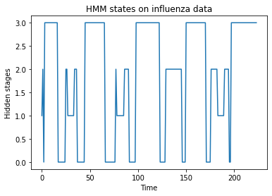
Initial Analysis
Influenza follows bubble behavior
Once trained, HMM can help detect hidden epidemic stages, apart from low-high
Crucial in early epidemic detection
Based on “Bayesian Markov switching models for the early detection of influenza epidemics”
Notes:
Toy experiment for starting the project

Slide 7

Workflow
Twitter (TWINT API)
Data Extraction
Identifying Sentiment
Feature Selection
Hidden Markov Model
Prediction

Slide 8

The Model – Hidden markov model
HMM was used to detect epidemic and non-epidemic states of sentiment scores for tweets
HMM has a number of underlying hidden states, which are transitioned between and each state has associated possible observations
Given an observed series of data an HMM can be used to identify the most likely hidden state the model is in at each data point.

Slide 9
Data ?
Tweets gathered from March’21 – Sept’21 with tags and keywords using Python’s twint library – [‘#dogecoin’, ‘#tothemoon’, ‘#dogefather’, ‘#dogecoinrise’, etc.] Over 100,000 raw tweets collected using the Twitter API.
Influenza Data for the period over the past decade, indicating the number of ILI cases in the US for all regions collected from CDC Website
Dogecoin prices (daily OHLC) for Mar’21-Sept’21 extracted from CoinDesk due to the epidemic like behavior of the coin’s value in the current year
New COVID Infections for US for the same period collected from Our World in Data with a 7-day rolling average.

Slide 10

EXPERIMENTs and results

Slide 11
Sentiment analysis on twitter data
Removal of duplicate tweets and converting the text to lowercase
Tokenizing the data and removing stopwords
Lemmatizing and stemming
Removing the symbols and special characters
Notes:
For this, the readily available pre-processingpackages were used as well as regular expressions,to remove the tags , quotes and question marksas they cause biased results for sentiment analysis.We used the combined lexicon and rule-based sen-timent analytic software Valence Aware Dictionaryand sEntiment Reasoner (VADER) [Hutto (2014)].It is capable of both, detecting the sentiment in-tensity in text and the polarity(positive, negative,neutral). Tweets with a positive opinion are as-signed Positive values while negative values areassigned to tweets with a negative opinion. Beingtailored explicitly to the sentiment of social media,VADER is generally expected to show positive re-sults. The polarity score is between -1 and 1, where-1 to 0 is negative, 0 to 1 is positive and 0 is neutral

Slide 12
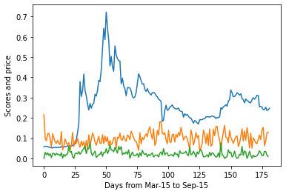
sentiment scores vs dogecoin
Sentiment scores were compared against the doge coin prices.
It’s hard to predict the prices solely based on the twitter sentiment scores since correlation is less.
Dogecoin follows an epidemic like pattern for the given time frame.
Need of an epidemic model can be inferred from this experiment.
Doge Coin

Slide 13
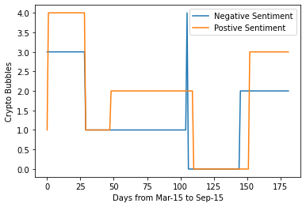
HMM on SOCIAL MEDIA ANALYSIS
Train HMM using both positive and negative twitter sentiments separately.
Repeated the training for several iterations to prevent it from falling into local maxima
Shows positive correlation with dogecoin prices in determining the epidemic stages
Clearly, early detection of boom and burst cycles in Dogecoin prices is possible
Notes:
n this experiment, we wish to achieve better predic-tion results using an HMM model. First, we usedtwitter positive sentiment to train the HMM modelwith five hidden states with each state represent-ing each stage in an crypto bubble. Since, HMMfollows expectation - maximization, we train themodel for different iterations to prevent it fromfalling into local maxima. After that, we trained an-other HMM model using twitter negative sentimentanalysis, we repeated the same steps as of positivesentiment HMM model to prevent it from fallinginto local maxima. After that we ran predictions onboth the models, the following results are plottedin figure 4

Slide 14
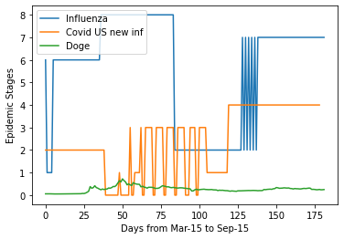
HMM on US INFLUENZA & COVID DATA
We trained two separate HMM models for both Covid and Influenza data.
First, a new HMM model is created with hidden states, then covid new infections data from the same period of 6 months is trained on it
Similarly influenza data for six months is collected and trained using HMM to detect hidden stages in the infections.
No effect on Doge Coin prices from epidemic signals directly.

Slide 15
Conclusions
Highlights how the techniques of epi-demic detection can be applied to Tweets for prediction of the Cryptocurrency price bubbles.
Like the spread of an infectious disease , ideas of investments also spread and form bubbles.
Epidemic and non-epidemic stages were learned and classified by the model.
Strong correlation between the DogeCoin prices and the behavior expressed by users on the internet while COVID and Influenza infections prove to be less useful.

Slide 16


Q-n-A ?

